Slide 1

Cancer Diagnosis Using Machine Learning

Slide 2
Team Members
Ram Nikhilesh Mekala
Srimanikanta Arjun Karimalammanavar
Project Guide
Dr. Vahid Behzadan

Slide 3
Project Motivation
The potential of machine learning within the medical industry is revealed through this in-depth example of how the technology can be applied to provide a medical diagnosis – in this case, diagnosis of Class of Cancer

Slide 4
Data
We have taken the data from Personalized Medicine: Redefining Cancer Treatment
Important features are Gene, Variation and Text(Clinical Evidence)
9 classes – number of classes the Genetic Mutation needs to classified on
We have 3000+ instances to classify and build our models on

Slide 5
Project Overview
Data
Data Pre-Processing
tSNE to Data
Feature Engineering
Word Embeddings Vector
ML & DL Models
Evaluation
Plotting Model Performance
Results

Slide 6
Data Pre-Processing
Cleaned Text by removing stopwords, replacing special character/multiple space with space, convert text into lowercase
Filled Empty Text rows using corresponding Gene and Variation values

Slide 7
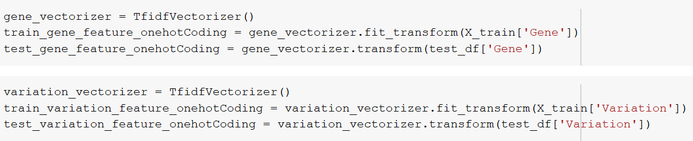
Feature Engineering
One-hot encoding to Gene and Variation using Tf-Idf Vectorizer
Constructed Word Embedding Vector using Tf-Idf Vectorizer and average Word2Vec on Text column

Slide 8
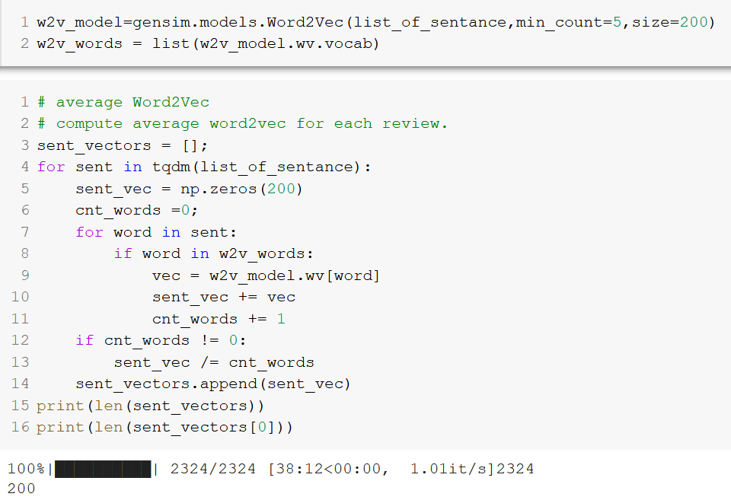
Average Word2Vec
Constructed Word2Vec based on our Training corpus with 200 dimensions

Slide 9
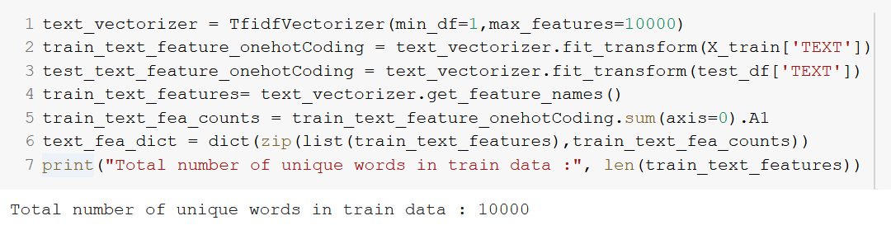
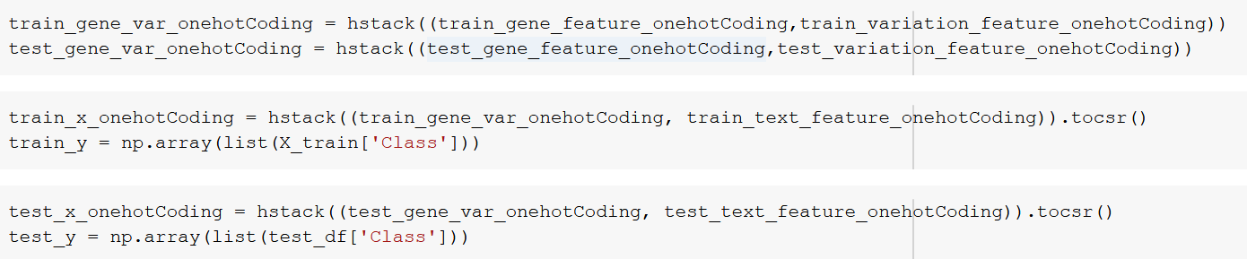
Normalized our data to avoid overfitting
Merged the features into a Single matrix using hstack()

Slide 10
Machine Learning Models
Support Vector Machines
Linear Kernel
Radial Basis Function Kernel
Multinomial Naïve Bayes Classifier
Used GridSearchCV to get the best Hyperparameters for models
Evaluation Metrics
Multi Class Log Loss
Confusion Matrix

Slide 11
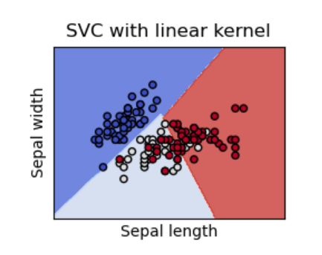
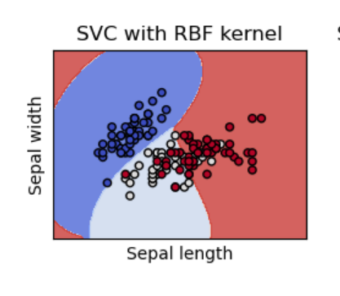
Support Vector Machines
SVMs focus on finding a hyperplane in an N-dimensional space that distinctly classifies the data points

Slide 12
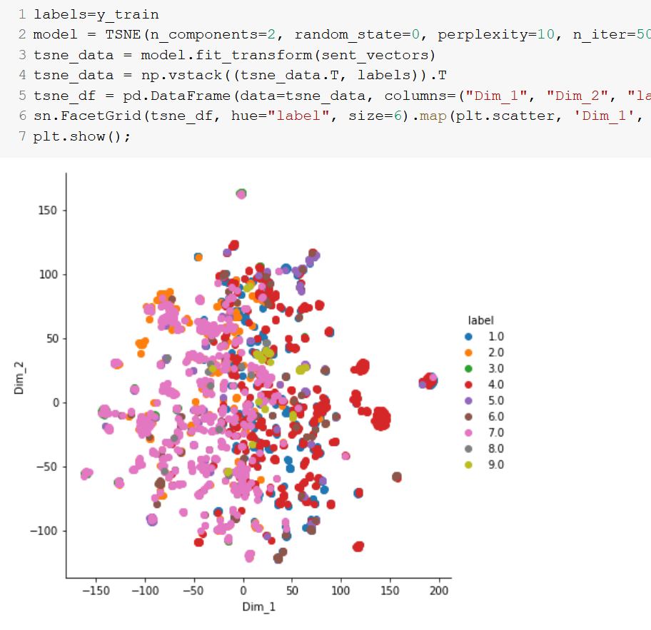
Why RBF Kernel?
Preferred when data is linearly non-seperable

Slide 13


SVM – Model Performance
SGD with hinge loss which is the equivalent of SVM with linear kernel (courtesy to computational limitations)
SVM with RBF Kernel

Slide 14
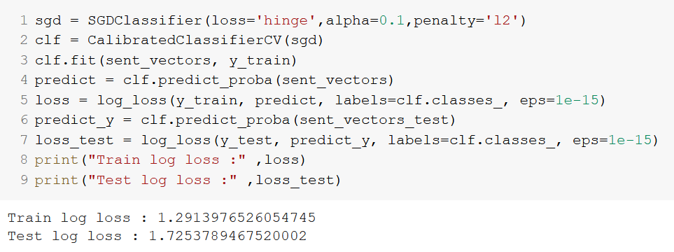
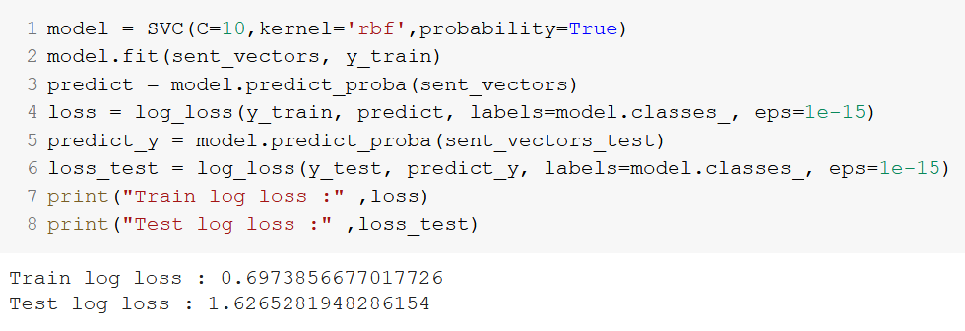
Code for SVMs
SVM – Linear Kernel
SVM – RBF Kernel

Slide 15
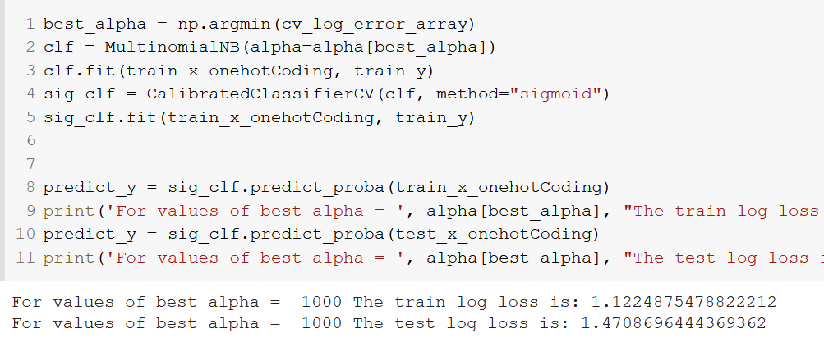
Naïve Bayes – Model Performance

Slide 16
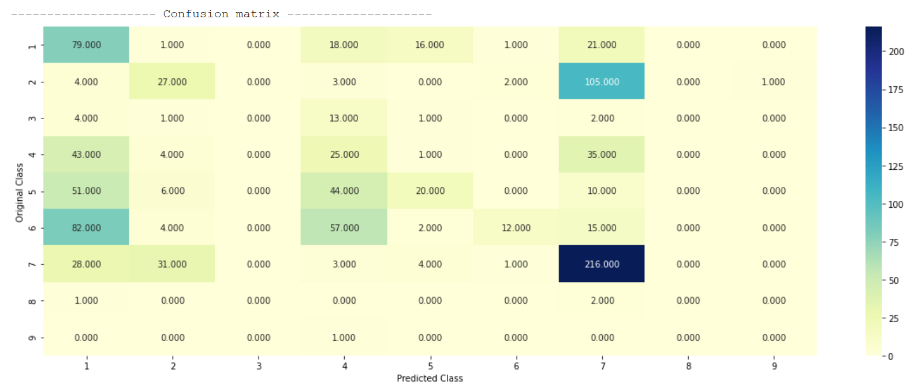
Confusion Matrix – SVM with RBF Kernel

Slide 17

Deep Learning Models
Long Short-Term Memory
Bidirectional Recurrent Neural Network using Gated Recurrent Units

Slide 18
Data Processing
Applied One-hot encoding to Gene and Variation adding it to TEXT column
Ranking words based on their frequencies
Applied Padding

Slide 19
Why Long Short-Term Memory?
Preserving long-term contextual relation is important in our data
LSTM uses Gates to retain “memory”
LSTM does this by overcoming Vanishing Gradient problem

Slide 20
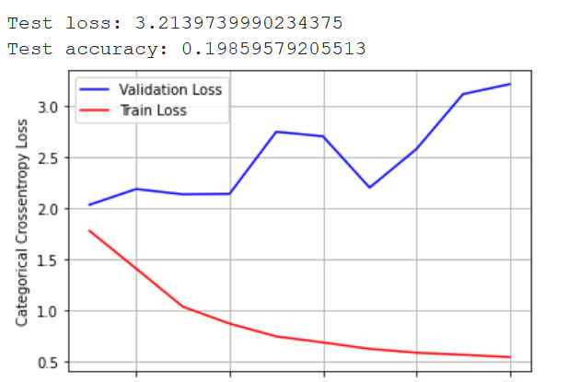
LSTM – Model Performance

Slide 21

Bidirectional RNN
Connects two hidden layers of opposite directions to the same output
GRUs have update gate

Slide 22
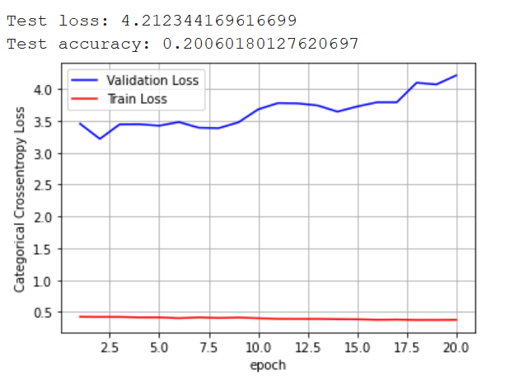
Bidirectional RNN – Model Performance

Slide 23
Conclusion
Models | Loss
Linear SVM | 1.313
SVM – RBF Kernel | 0.697
Naïve Bayes | 1.122
Long Short-Term Memory | 0.5410
Bidirectional RNN | 0.3762
Bidirectional RNN has performed
well comparatively.

Slide 24


Thank you…!

